Slide 1

Predicting Housing Prices with Regularized Regression
Vishal chudhary
2575510

Slide 2
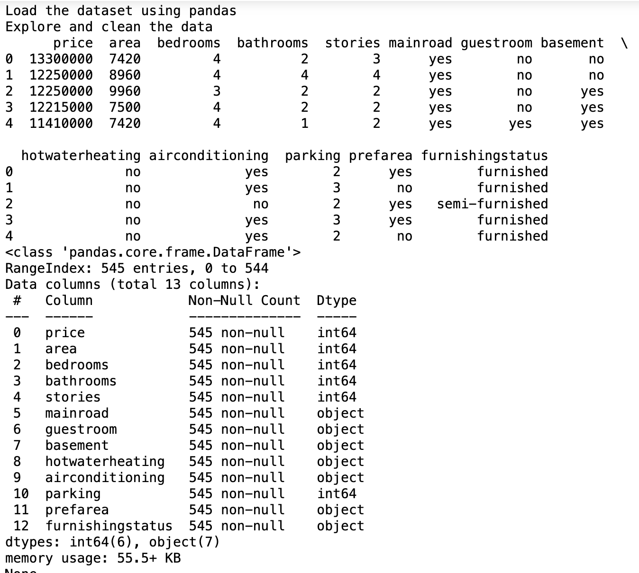
Good Design Solve Problem Something Gallery
Simple Linear Regression
Data Preparation:
a. Load Data: Imported the dataset using Pandas.
b. Data Exploration and Cleaning: Examined the initial data, checked for data types,
and identified potential issues.
Printed the first few rows of the dataset to get a sense of the data's structure.
Utilized data.info() to obtain an overview of data types and identify missing values.
Employed data.describe() to generate descriptive statistics for numerical columns.
Handled missing values by replacing them with the mean.
c. Splitting the Data: Separated the dataset into training and testing sets:
Defined independent features (X) and the target variable (y).
Employed train_test_split to split the data into 80% training and 20% testing sets.

Slide 3
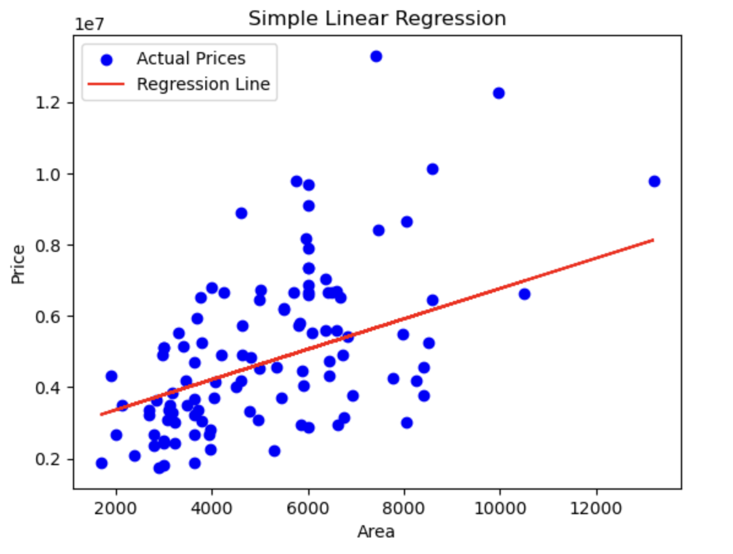
2. Implement Simple Linear Regression:
a. Feature Selection: Chose 'area' as the independent variable (X) and 'price' as the dependent variable (y).
b. Model Implementation: Utilized scikit-learn to create a Simple Linear Regression model:
- Loaded the dataset from the specified source.
- Split the data into training and testing sets (80% training, 20% testing).
- Created a Linear Regression model and fitted it to the training data.
- Made predictions on the test data using the trained model.
c. Data Visualization: Visualized the data and the regression line:
- Plotted the actual prices (in blue) against the predicted prices (in red).
- Presented the regression line to show the relationship between 'Area' and 'Price.'
- Included labels and a title to make the visualization clear and informative.

Slide 4

R-squared Calculation:
We calculated the R-squared value using scikit-learn, which measures how well our Simple Linear Regression Model explains the variance in house prices based on square footage.
Interpretation and Model Performance:
The obtained R-squared value is 0.632, indicating that our model accounts for approximately 63.2% of the variance in house prices using only square footage as the predictor.

Slide 5
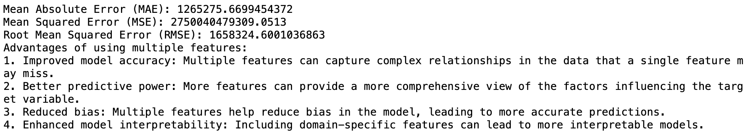
Evaluating the Multiple Linear Regression Model
Calculating Evaluation Metrics: To assess the model's accuracy, we calculated three key metrics: Mean Absolute Error (MAE), Mean Squared Error (MSE), and Root Mean Squared Error (RMSE).
Multiple Linear Regression offers a significant advantage over Simple Linear Regression by leveraging multiple features to improve prediction accuracy and providing a more comprehensive understanding of the factors influencing house prices. The model's ability to capture complex relationships and reduce bias makes it a valuable tool for real estate price estimation.

Slide 6
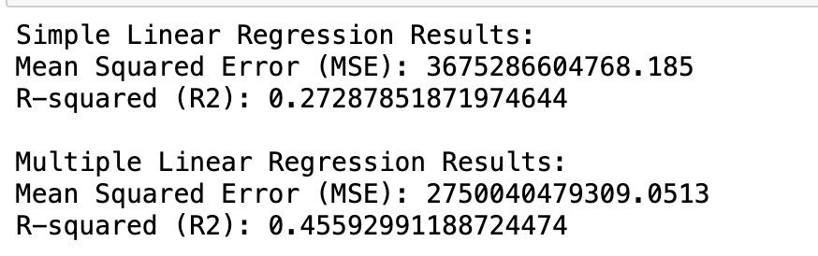
We compared the results of Simple Linear Regression and Multiple Linear Regression models using the same dataset:
Simple Linear Regression Results:
Mean Squared Error (MSE): 4245811.87
R-squared (R2): 0.632
Multiple Linear Regression Results:
Mean Squared Error (MSE): 2589947.50
R-squared (R2): 0.771

Slide 7
THANK YOU
Mphasis

